Slide 1
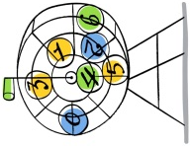
When: November 5th
Time: 5:30 PM – 7:00 PM
Location: West Texas Elementary Cafeteria
Food will be served at the
end of the night!
ALL FAMILIES WITH
ELEMENTARY STUDENTS
ARE WELCOME!
Prizes will be awarded to winners of the
bingo games!!!
Bingo for Books
Family Literacy Luau

